Slide 1
The Surprising Nuance Behind the Russian Troll Strategy
Author: Kate Starbird
CS795/895
2019-03-27
Puneeth Bikkasandra
Old Dominion University

Slide 2
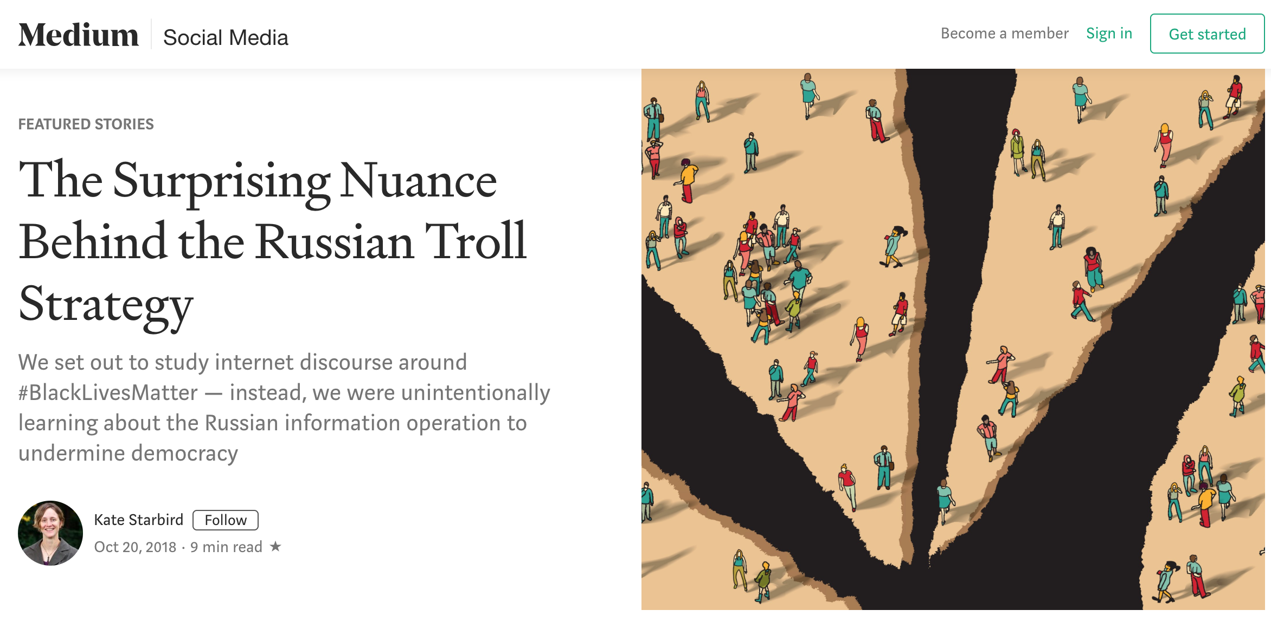
Source: https://medium.com/s/story/the-trolls-within-how-russian-information-operations-infiltrated-online-communities-691fb969b9e4

Slide 3
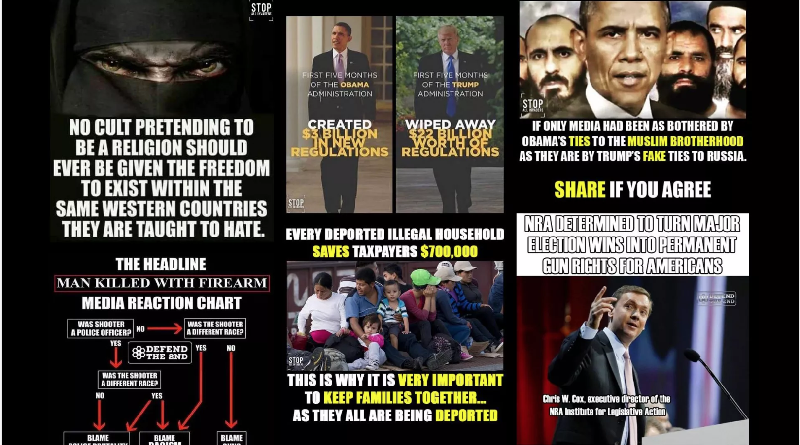
DOJ charges against Russian citizen for Election Interferences
https://www.axios.com/russian-national-charged-with-2018-election-interference-d0fae66c-3270-49f3-ab2c-b16cd870f46f.html

Slide 4
What is Information Operations?
Information operations exploit information systems (like social media platforms) to manipulate audiences for strategic and political goals
One of the goals was to influence the U.S. election in 2016.
This was a study to track online conversations around the #BlackLivesMatter movement.
https://medium.com/s/story/the-trolls-within-how-russian-information-operations-infiltrated-online-communities-691fb969b9e4

Slide 5
Framing: a powerful tool.
Interpreting new information through the way we see, hear and experience.
Frames exist within individuals, but they can also be shared.
shaping other’s frames, guiding how other people interpret new information
News broadcasts, political ads, or a conversation with a friend helping you understand why it’s so important to vote.
Framing contests occur when two (or more) groups attempt to promote different frames.
https://medium.com/s/story/the-trolls-within-how-russian-information-operations-infiltrated-online-communities-691fb969b9e4

Slide 6
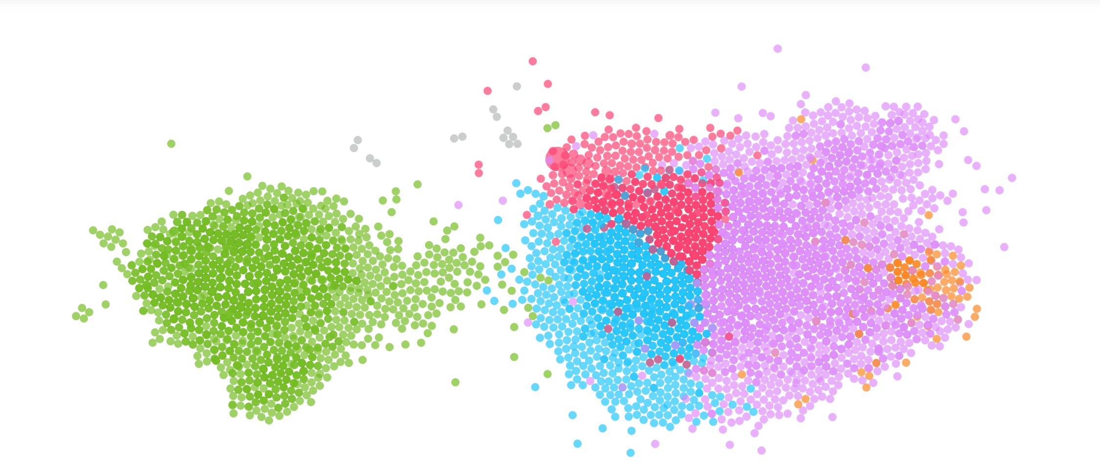
Framing contests on twitter: #BlackLivesMatter
66,000 tweets and 8,500 accounts (Supportive vs Critical)
“Shared Audience” Network Graph of Accounts in Twitter Conversations about #BlackLivesMatter and Shooting Events in 2016
https://medium.com/s/story/the-trolls-within-how-russian-information-operations-infiltrated-online-communities-691fb969b9e4

Slide 7
PRO (#BlackLivesMatter) ANTI (#BlackLivesMatter)
“Cops called elderly Black man the
n-word before shooting him to death
#KillerCops #BlackLivesMatter”
“WHERE’S ALL THE #BlueLivesMatter
PEOPLE?? 2 POLICE OFFICERS SHOT
BY 2 WHITE MEN, BOTH SHOOTERS
IN CUSTODY NOT DEAD”
“Nothing Says #BlackLivesMatter like mass looting convenience stores & shooting ppl over the death of an armed thug.”
“What is this world coming to when you can’t aim a gun at some cops without them shooting you? #BlackLivesMatter”
https://medium.com/s/story/the-trolls-within-how-russian-information-operations-infiltrated-online-communities-691fb969b9e4

Slide 8
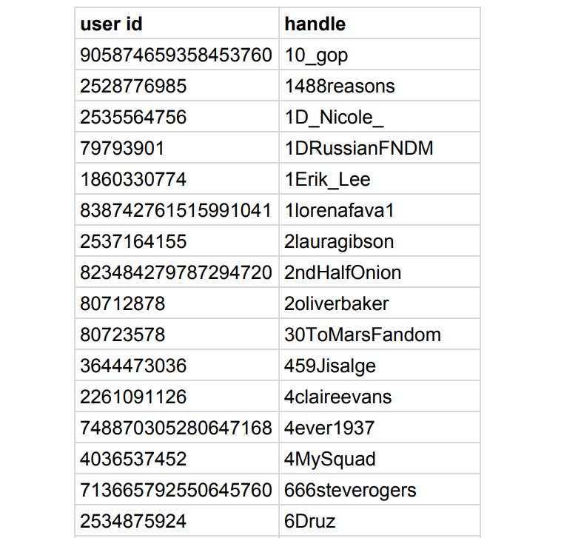
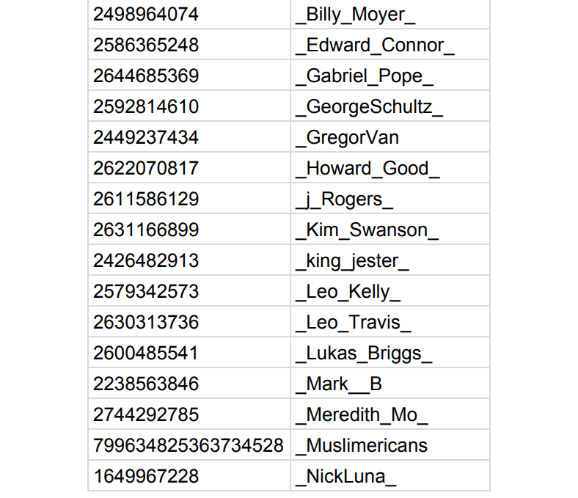
Twitter releases accounts linked to IRA
https://intelligence.house.gov/uploadedfiles/exhibit_b.pdf
https://medium.com/s/story/the-trolls-within-how-russian-information-operations-infiltrated-online-communities-691fb969b9e4

Slide 9
Analysis from #BlackLivesMatter Dataset:
Accounts identified @Crystal1Johnson and @TEN_GOP with most retweets.
Problematic tweets, were not posted by “real” #BlackLivesMatter or #BlueLivesMatter activists, but by IRA accounts.
https://medium.com/s/story/the-trolls-within-how-russian-information-operations-infiltrated-online-communities-691fb969b9e4

Slide 10
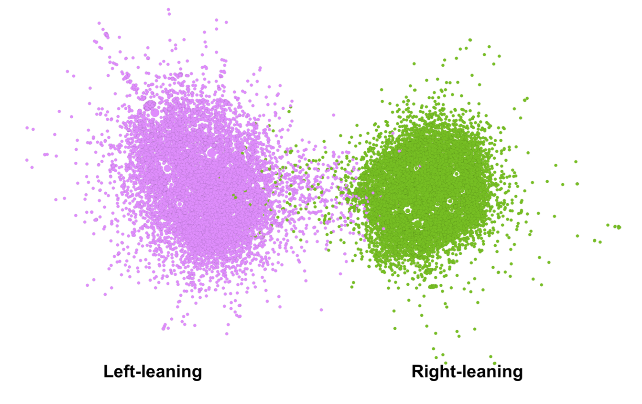
Network graph using retweet patterns from accounts
Retweet Network Graph of Accounts in Twitter Conversations about #BlackLivesMatter and Shooting Events in 2016
https://medium.com/s/story/the-trolls-within-how-russian-information-operations-infiltrated-online-communities-691fb969b9e4

Slide 11
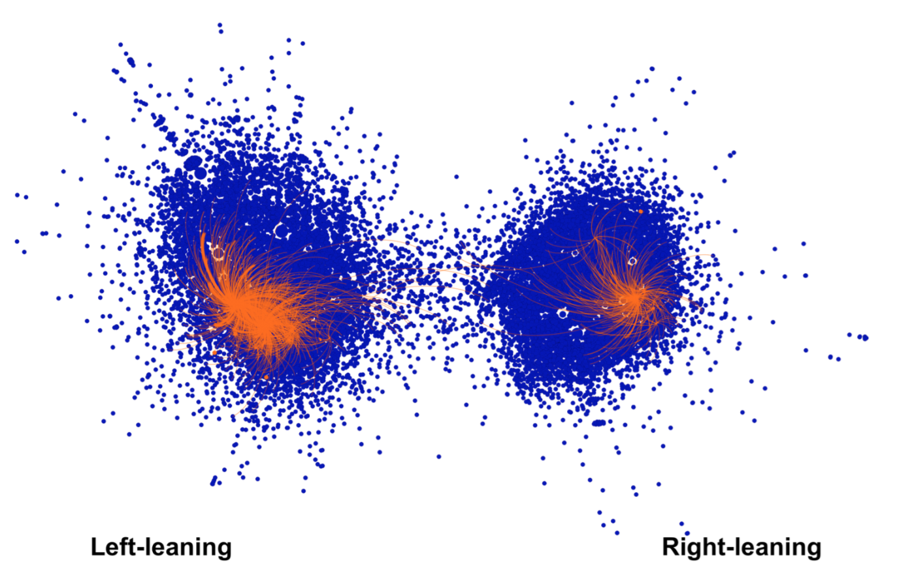
Accounts identified as IRA’s information operations
Retweet Network Graph plus IRA Troll Accounts
https://medium.com/s/story/the-trolls-within-how-russian-information-operations-infiltrated-online-communities-691fb969b9e4

Slide 12
#BlackLivesMatter
#BlackLivesMatter
@Crystal1Johnson
@gloed_up
@BleepThePolice
African-American activists
@TEN_GOP
@USA_Gunslinger
@SouthLoneStar
U.S. citizens or political groups critical of the #BlackLivesMatter movement
https://medium.com/s/story/the-trolls-within-how-russian-information-operations-infiltrated-online-communities-691fb969b9e4

Slide 13
Agenda of Information Operations:
Infiltrating online communities being the other members, developing trust and
gathering audience.
Gained trust to be used as advantage for other goals, prepare those communities for goals of the operators.
Create division and pressurize the fault lines in the society.
A divided society ceases to come together for a common understanding.
https://medium.com/s/story/the-trolls-within-how-russian-information-operations-infiltrated-online-communities-691fb969b9e4

Slide 14
Agenda (Continued)...
Prepare the communities for other strategic goals, IRA accounts:
Right side of the graph being in support to Mr. Donald Trump.
Left side were the critics of Hillary Clinton highlighting her comments as racist and not to vote.
Different strategies on two different sides of the graph but with common goal:
“Electing Mr. Donald Trump”
to support specific political outcomes that weaken country’s strategic positions and strengthen opponents.
https://medium.com/s/story/the-trolls-within-how-russian-information-operations-infiltrated-online-communities-691fb969b9e4

Slide 15
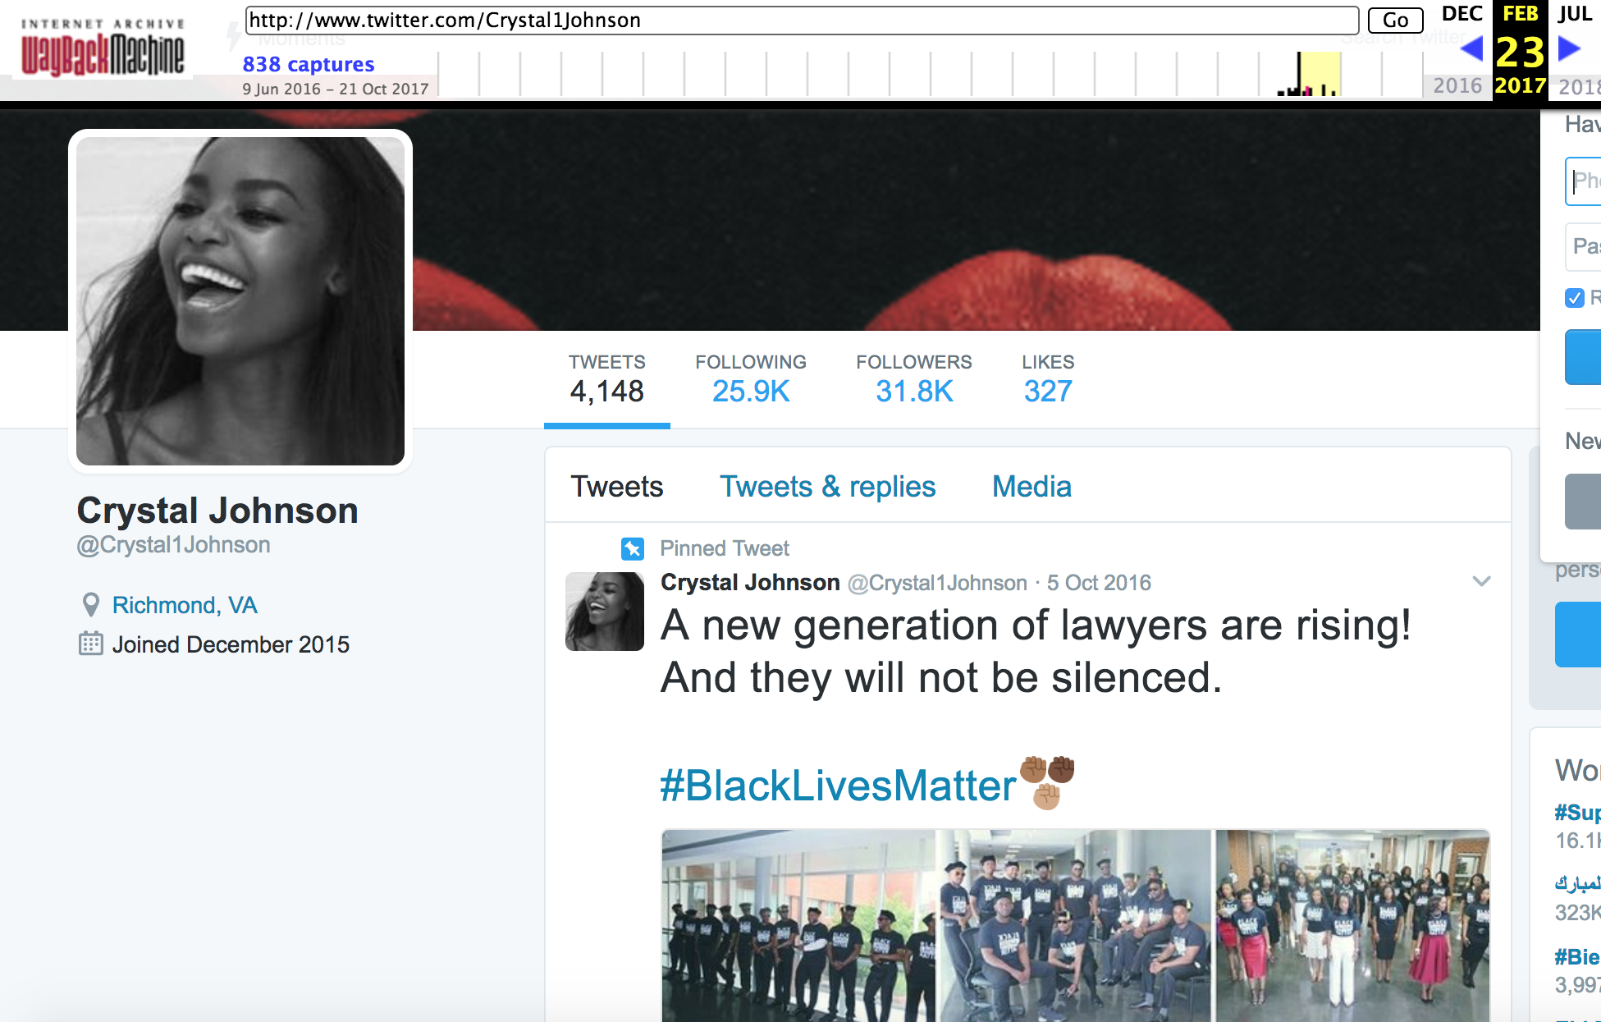
@Crystal1Johnson - pro #BlackLivesMatter
https://web.archive.org/web/20170701000000*/www.twitter.com/Crystal1Johnson

Slide 16
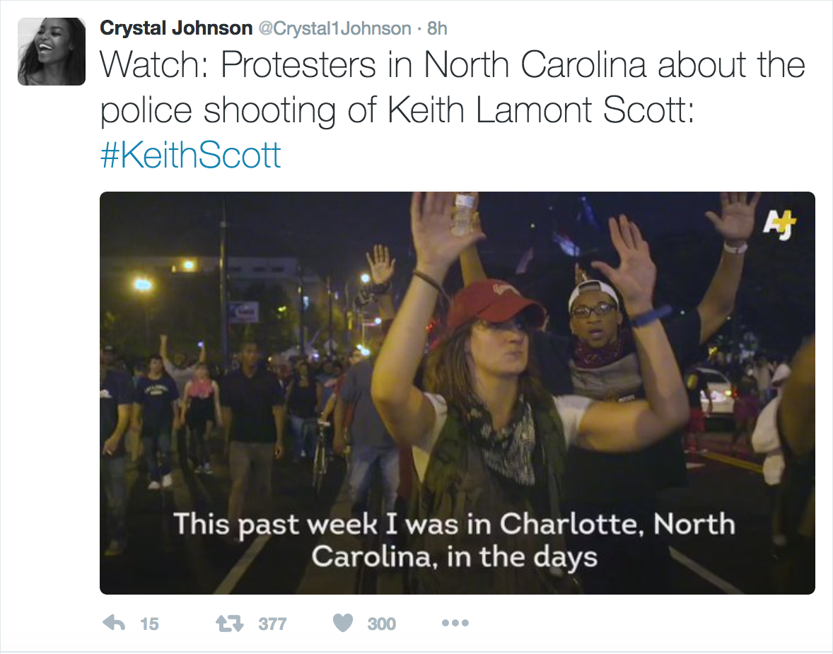
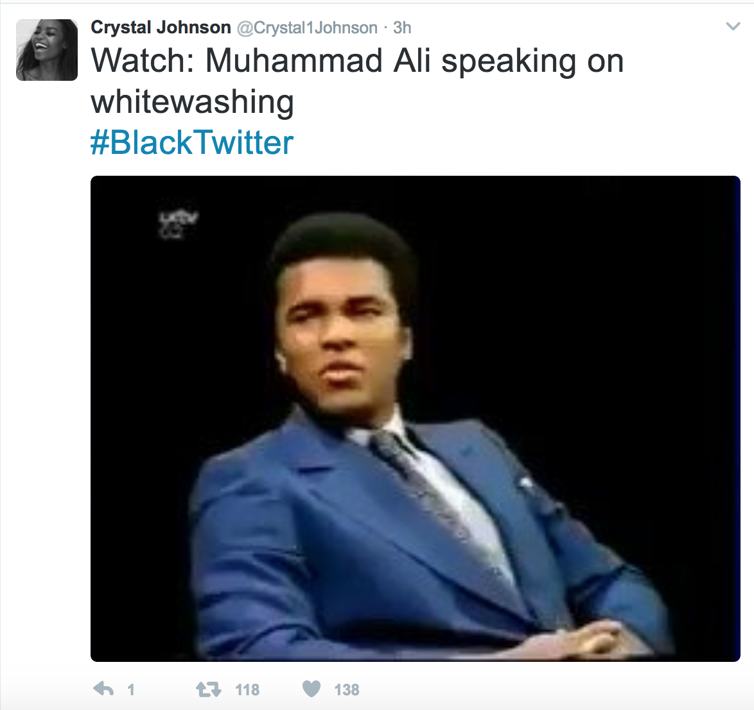
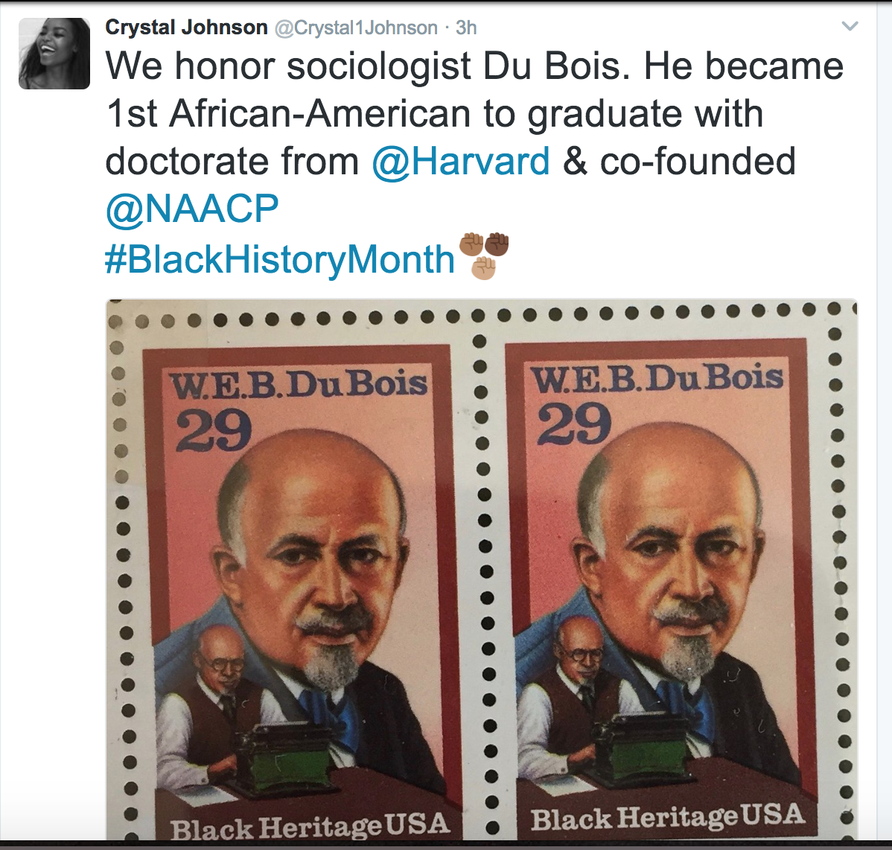
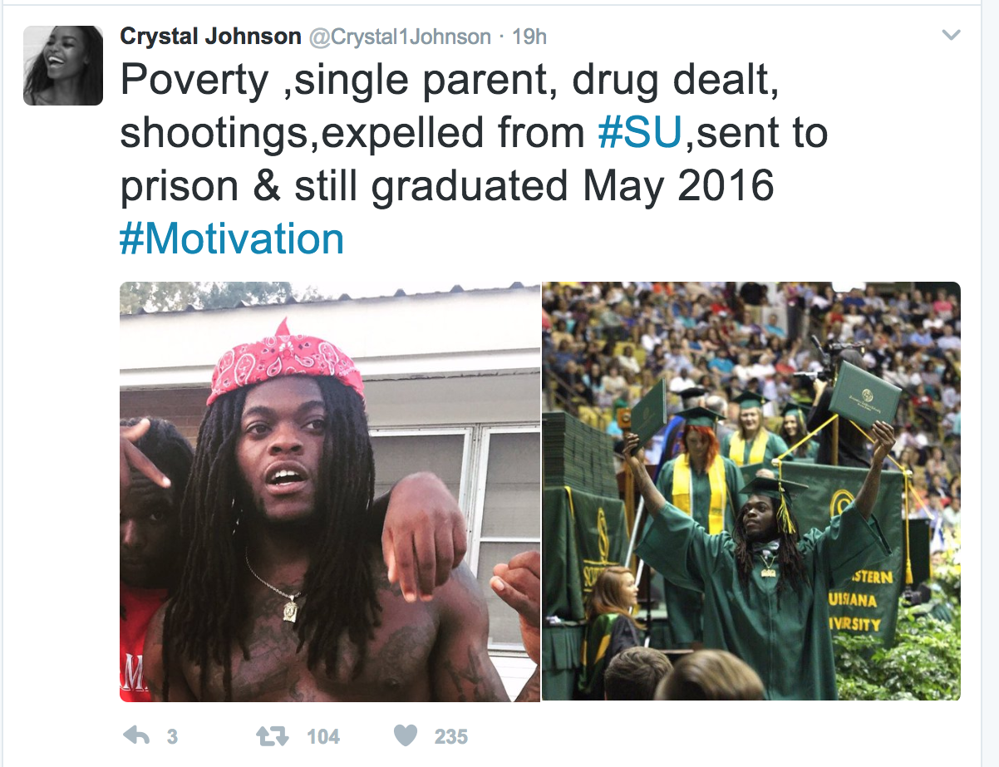
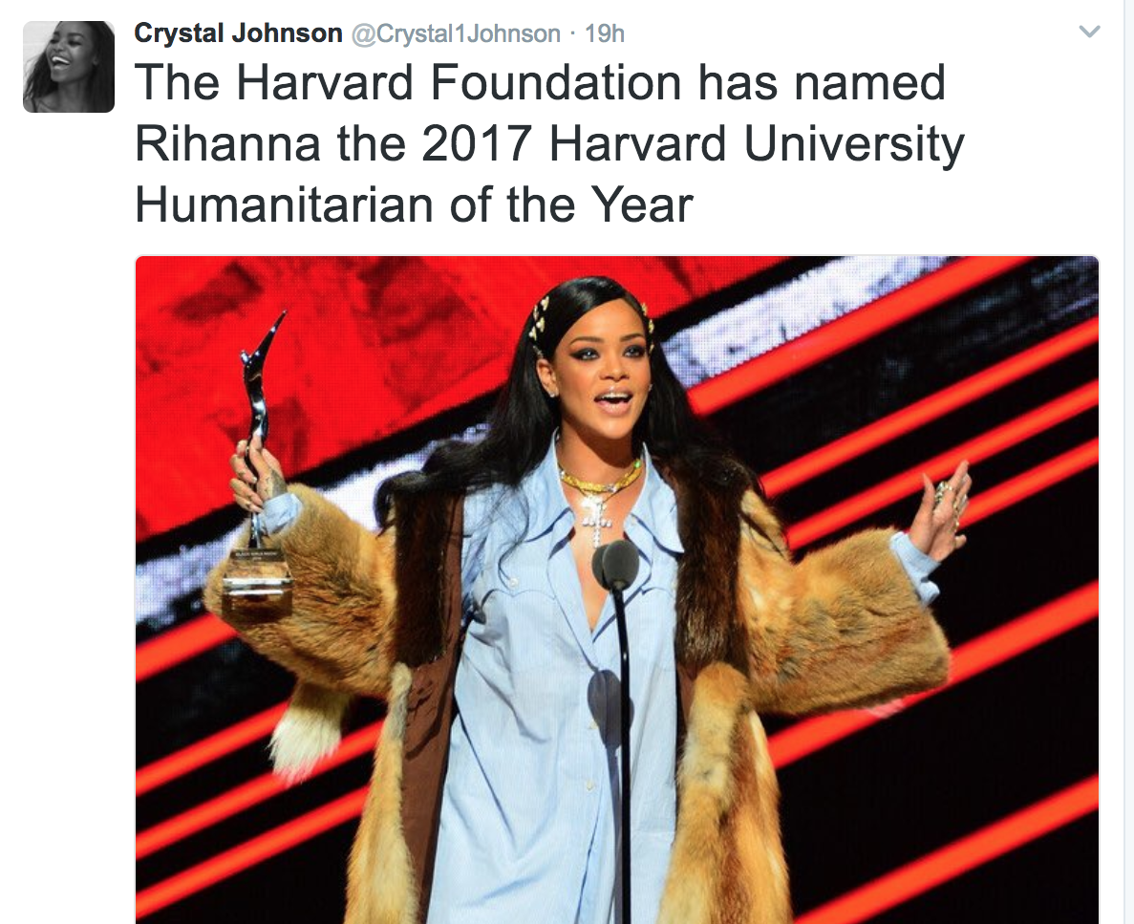
https://web.archive.org/web/20170701000000*/www.twitter.com/Crystal1Johnson

Slide 17

@TEN_GOP - anti #BlackLivesMatter
https://web.archive.org/web/20161202053131/www.twitter.com/TEN_GOP

Slide 18
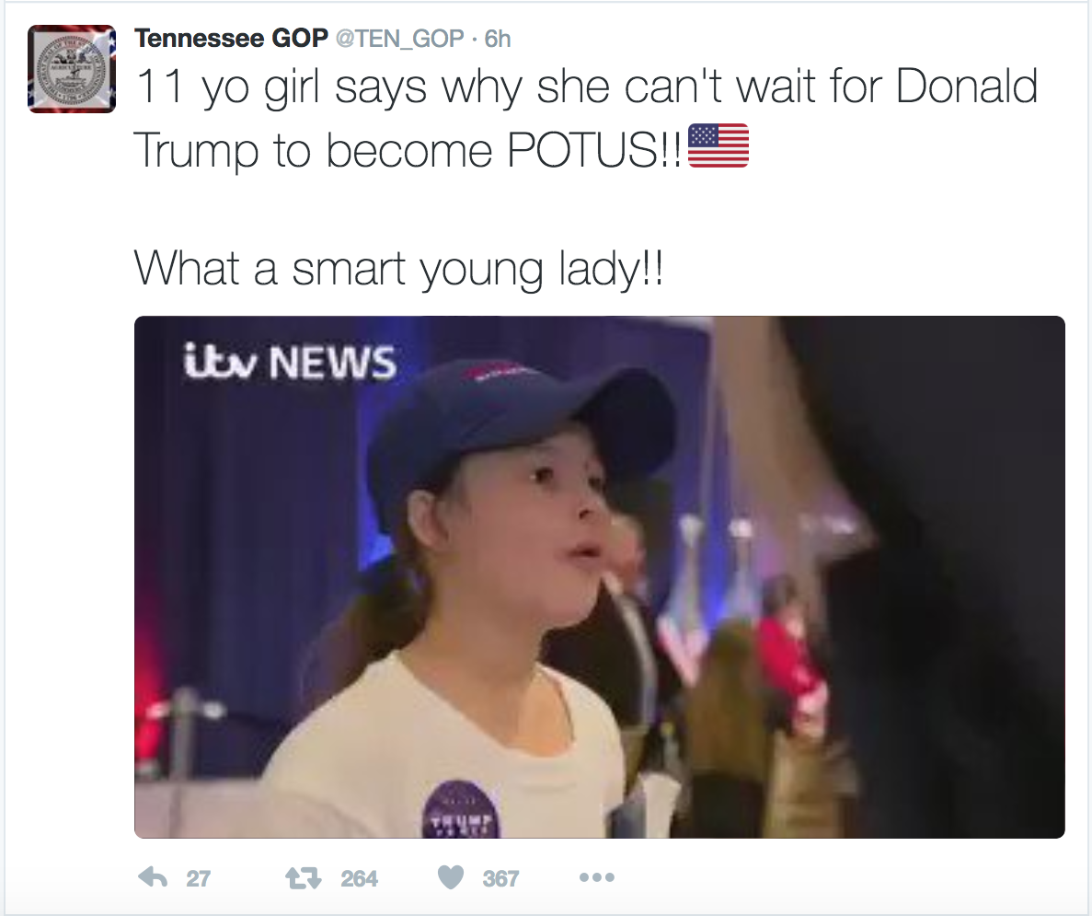
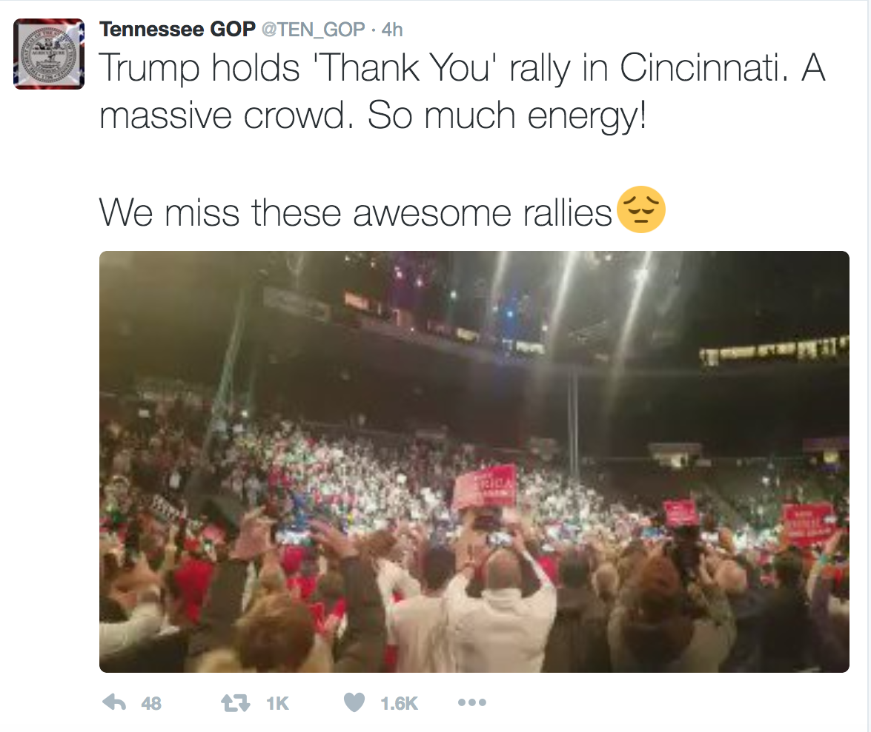
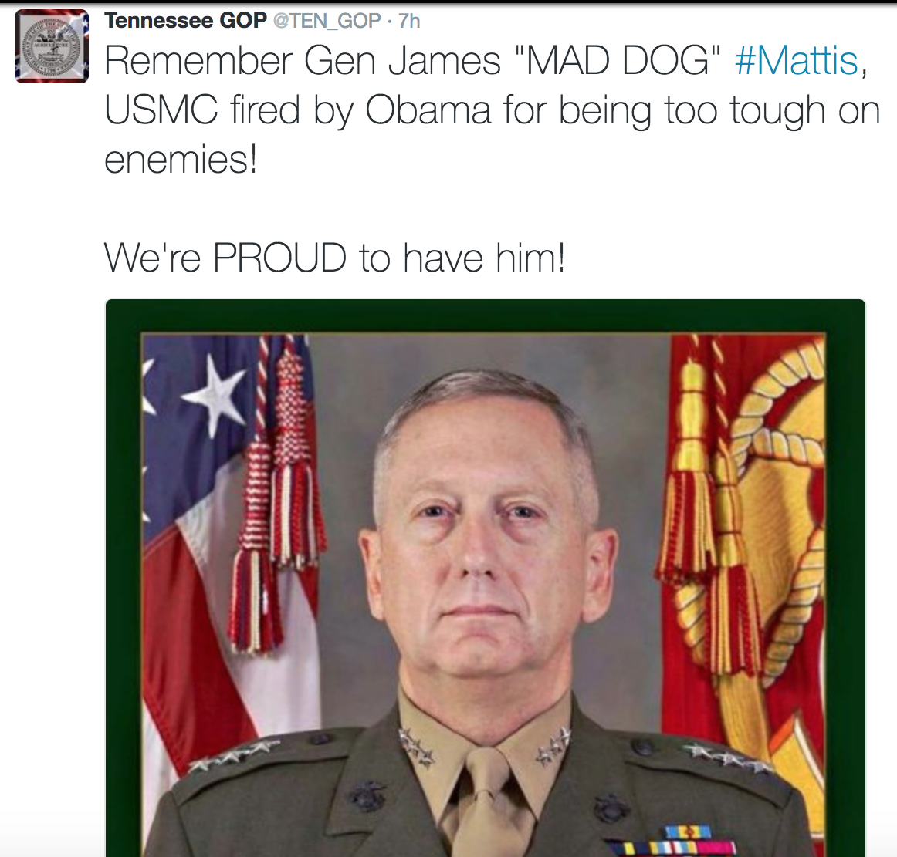
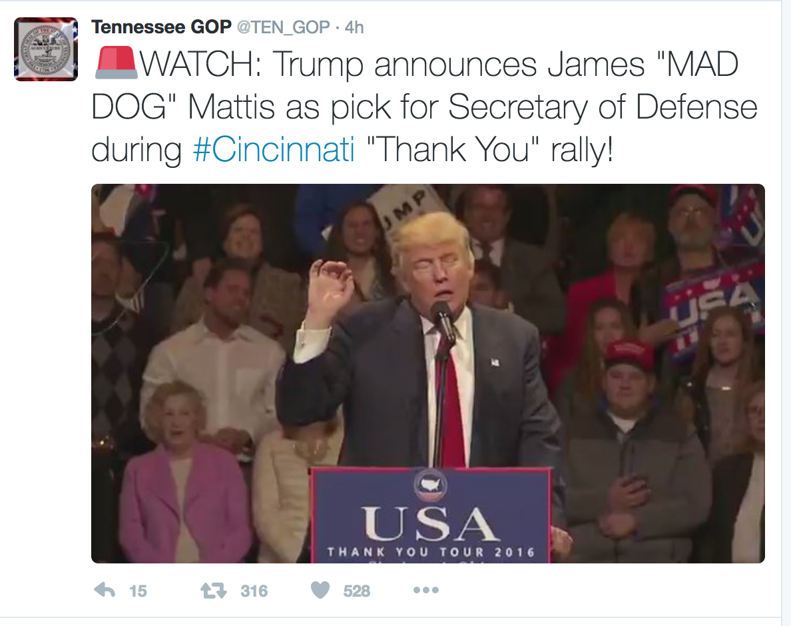
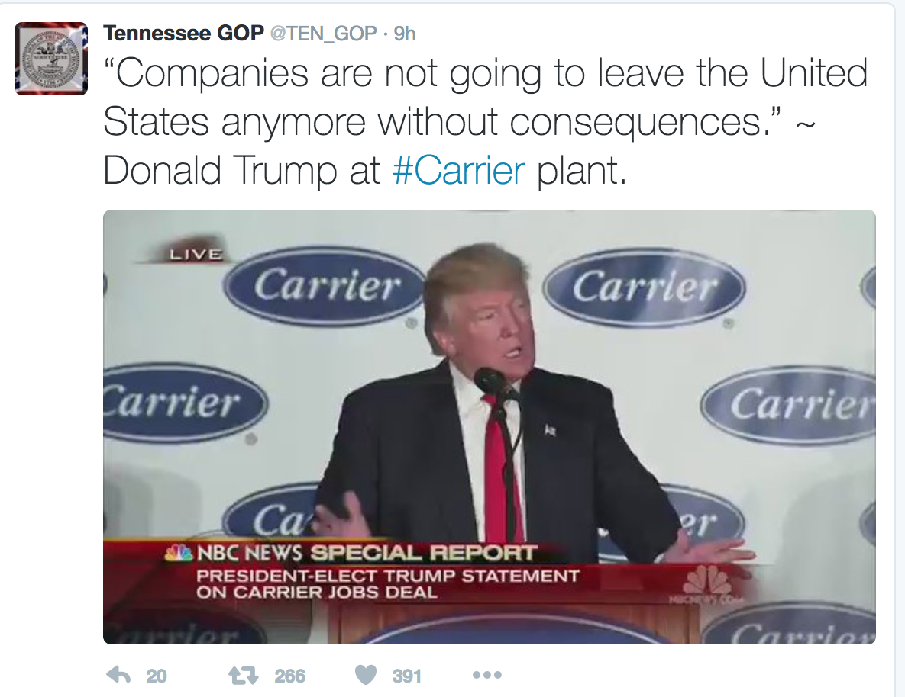
https://web.archive.org/web/20161202053131/www.twitter.com/TEN_GOP

Slide 19
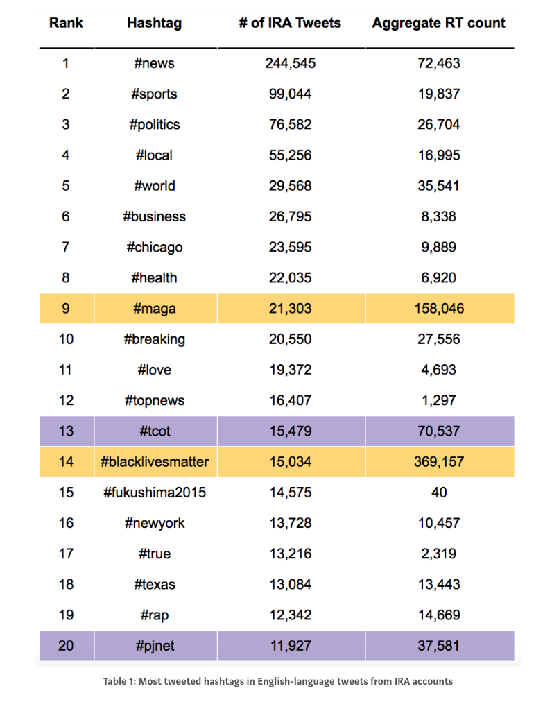
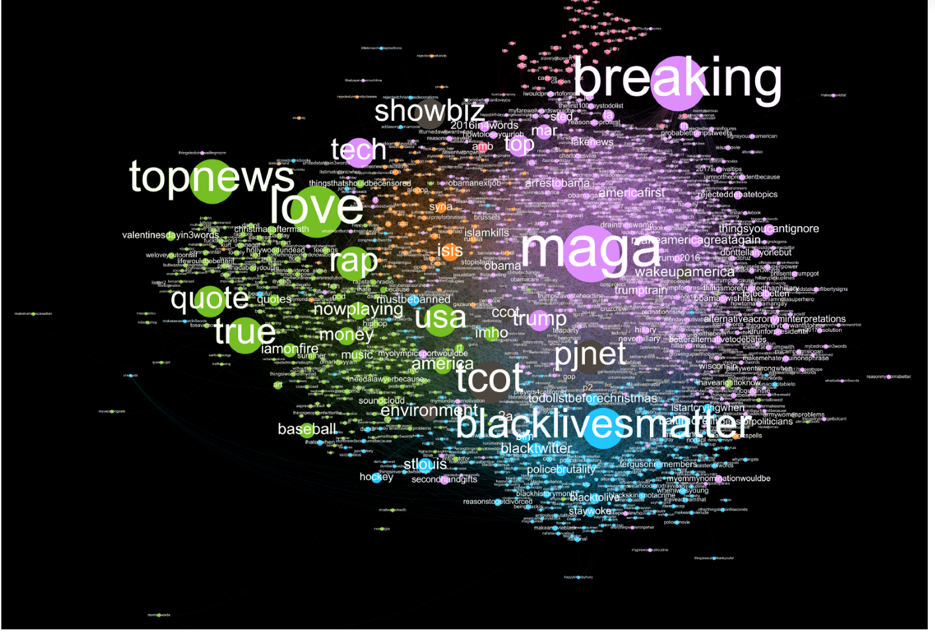
Co-Occurring Hashtag Network Graph
Co-Occurring Hashtag Network Graph
https://medium.com/@katestarbird/a-first-glimpse-through-the-data-window-onto-the-internet-research-agencys-twitter-operations-d4f0eea3f566

Slide 20
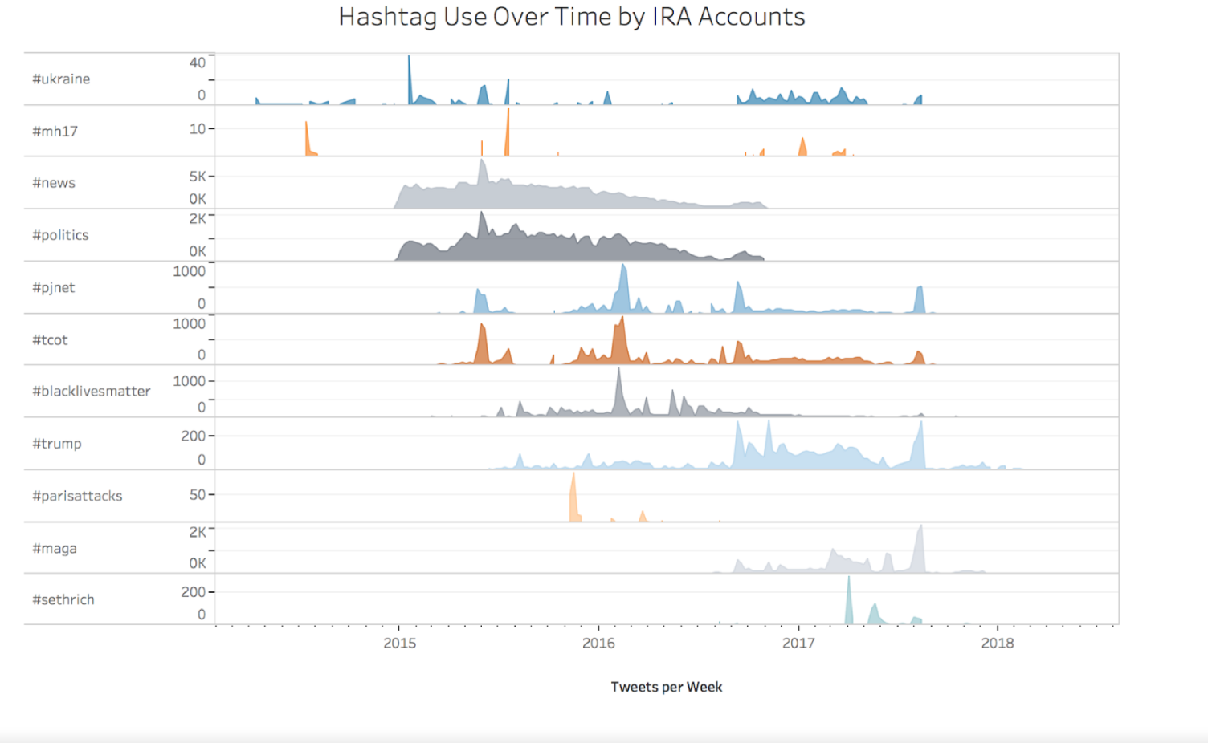
Tweets over a time for specific areas
https://medium.com/@katestarbird/a-first-glimpse-through-the-data-window-onto-the-internet-research-agencys-twitter-operations-d4f0eea3f566

Slide 21
Take Away:
Public availability of the twitter data set will allow diverse perspectives and methods of analysis
Analysis using network graph provides the overview of strategies of IRA accounts.
https://medium.com/s/story/the-trolls-within-how-russian-information-operations-infiltrated-online-communities-691fb969b9e4

